Slide 1

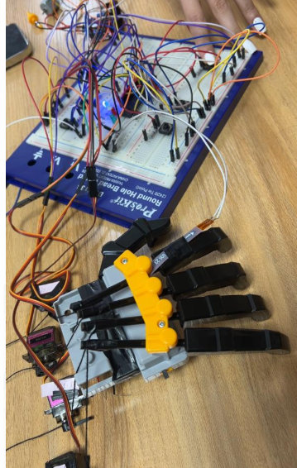
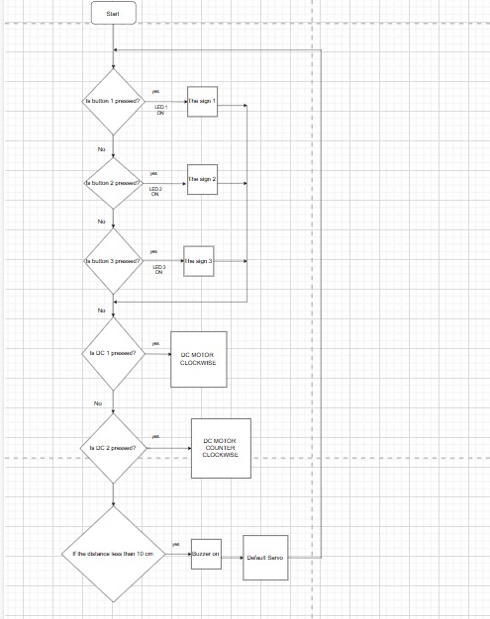
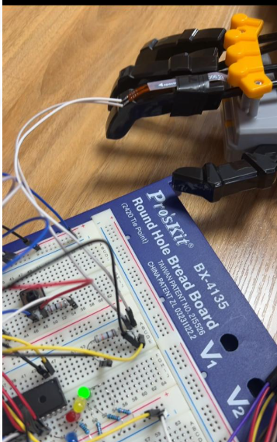
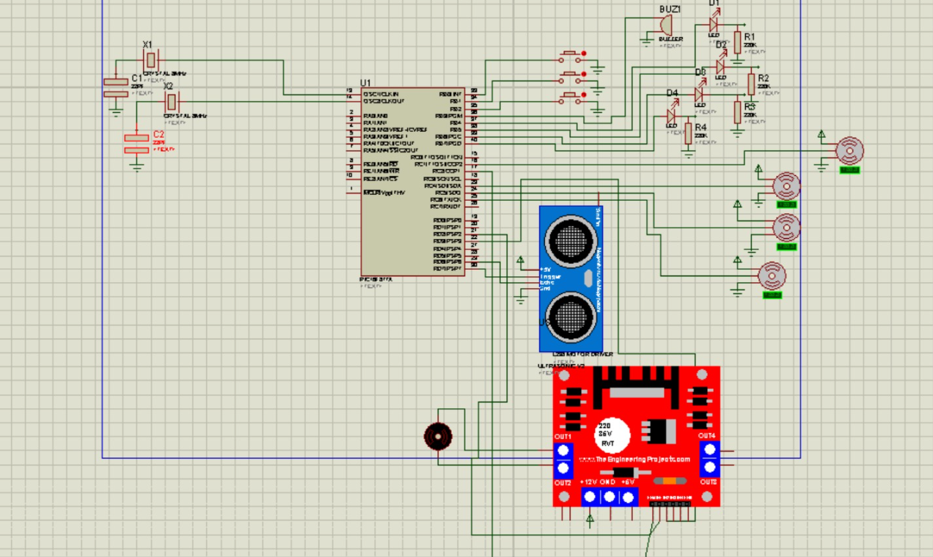
Finger Tapping Hand
Z.Hasan, T.Howari, L.Hussam
Supervisor: Dr. Esam Qaralleh
Embedded Systems Final Design Project, Fall 2024
King Abdullah II School of Engineering
Princess Sumaya University for Technology
After coding and building we achieved these results as shown below in the figures.
Figure 1: Simulating the first sign
Introduction:
The project aims to create a robotic hand that performs sign language gestures to aid communication for individuals with hearing or speech impairments. It uses sensors to detect finger movements, motors for gesture reproduction, and input devices. The system incorporates embedded to ensure precise gesture simulation. The goal is to develop an efficient, safe, and user-friendly tool that replicates common sign language gestures, promoting accessibility and inclusion for people with disabilities.
Design:
This design uses flex sensors, limit switches, and a few LEDs to show the state of our operations. It is based on a pic16F877A microcontroller that is interfaced with a robotic hand that mimics finger tapping and sign language.
Figure 2: Testing Flex Sensor
Software Design Flowchart
Circuit Design
Conclusion:
The robotic hand project successfully simulates basic sign language gestures, improving communication for individuals with hearing or speech impairments. Challenges in mechanical design were resolved by adjusting servo placement, and electrical components worked together with safety features. Issues with PWM generation and sensor accuracy were addressed through hardware and software optimizations. The project highlights the potential of robotic systems for sign language translation and finger tapping.

